Slide 1
Training of design testing using gtkwave
Objective: To test the devices
Apparatus: We have Design (Simulation model)
Method:
Generate signal from testbench and supply to design modules
Verify in gtkwave
How to generate signal?
Clock signal
Counter
What are the types of signal?
Decimal
Hexadecimal

Slide 2
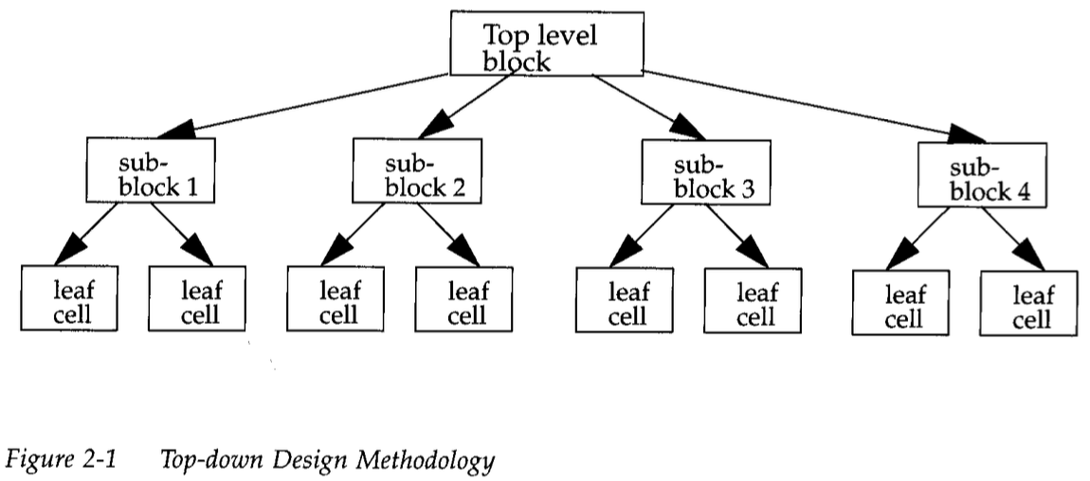
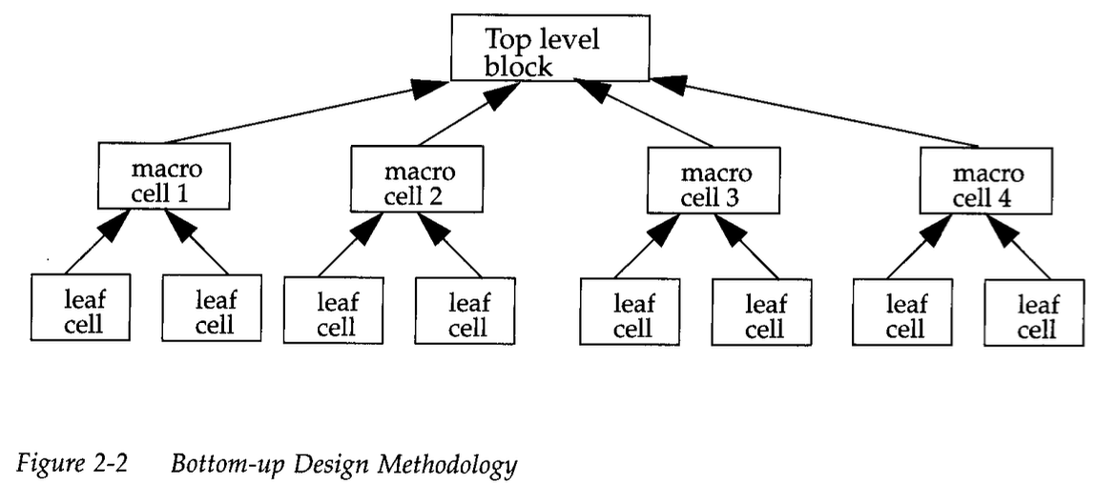

Slide 3
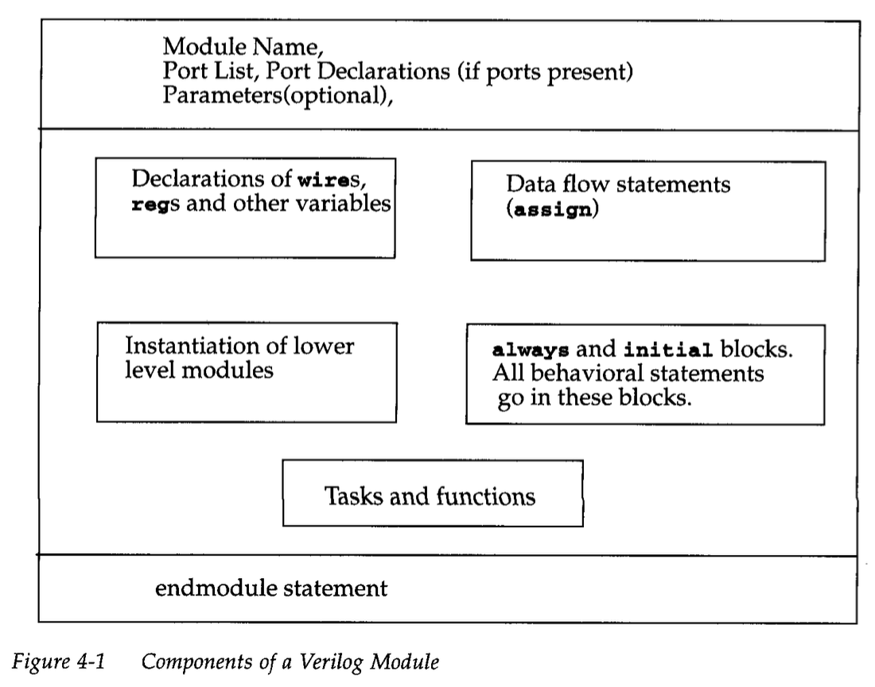

Slide 4
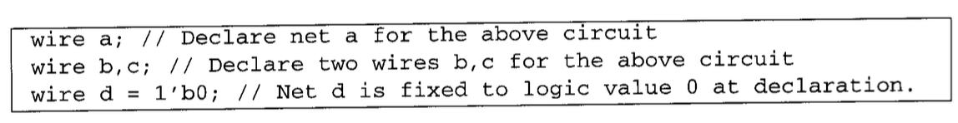
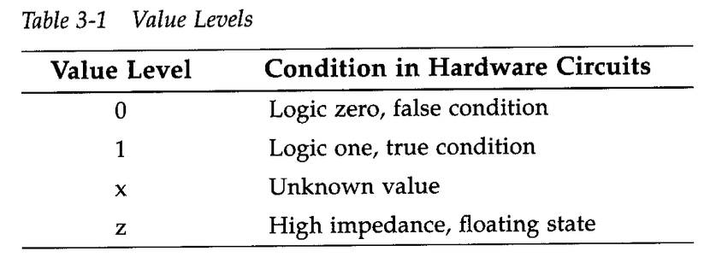
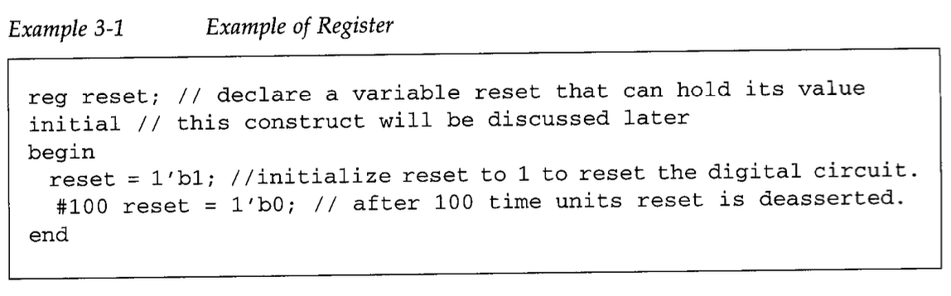
Data types
Nets represent connections between hardware elements. Just as in real circuits, nets have values continuously driven on them by the outputs of devices that they are connected to. In Figure 3-1 net a is connected to the output of a n dgate g1. N e ta will continuously assume the value computed at the output of gate g1, which is b & C.
Registers represent data storage elements. Registers retain value until another value is placed onto them. Do not confuse the term registers in Verilog with hardware registers built from edge-triggered flip-flops in real circuits. In Verilog, the term register merely means a variable that can hold a value.

Slide 5
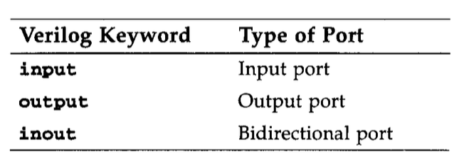
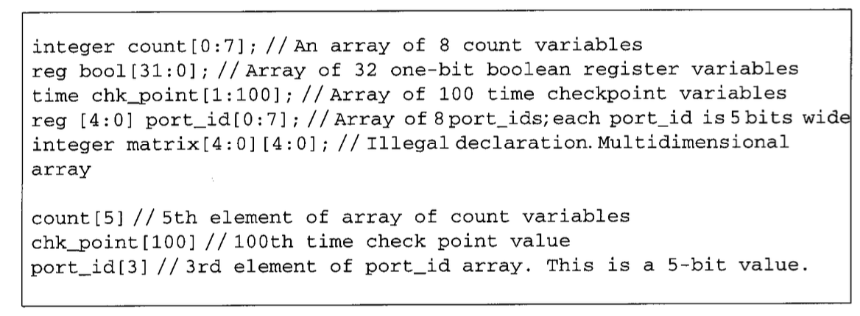
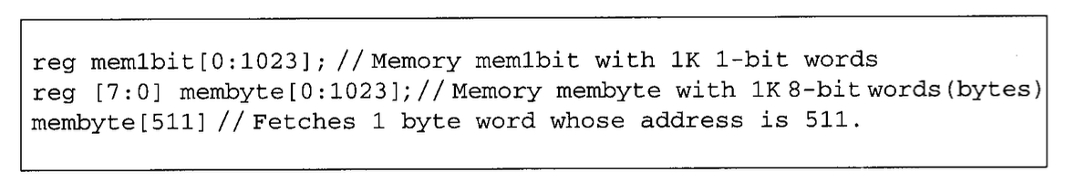

Slide 6
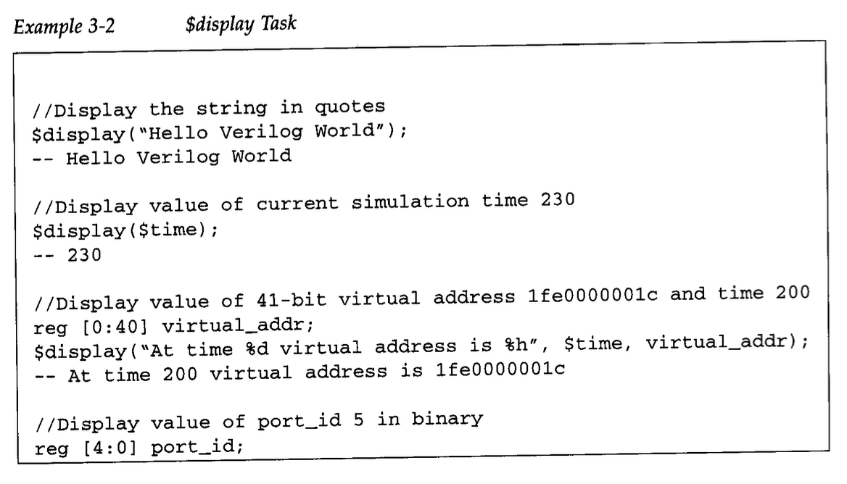
Display

Slide 7
Method for designing UART hardware
Transmitter
Baud clock generator
Receiver
Transmitter
Baud clock generator
Receiver

Slide 8
